Slide 1



DIY IoT Devices
LombokDev Meetup
Getting Started
Pahrizal Ma’rup
lombokthinker@gmail.com
@lombokthinker

Slide 2
Foolish Assumptions
Penasaran
Suka Ngoprek
Punya tempat

Slide 3

DO
Double check your work
Well ventilated room
Disconnect power when you smell anything burning
Think twice before you cut anything
DON’T
Work on AC powered devices when its ON
Wiring up circuit when its ON

Slide 4
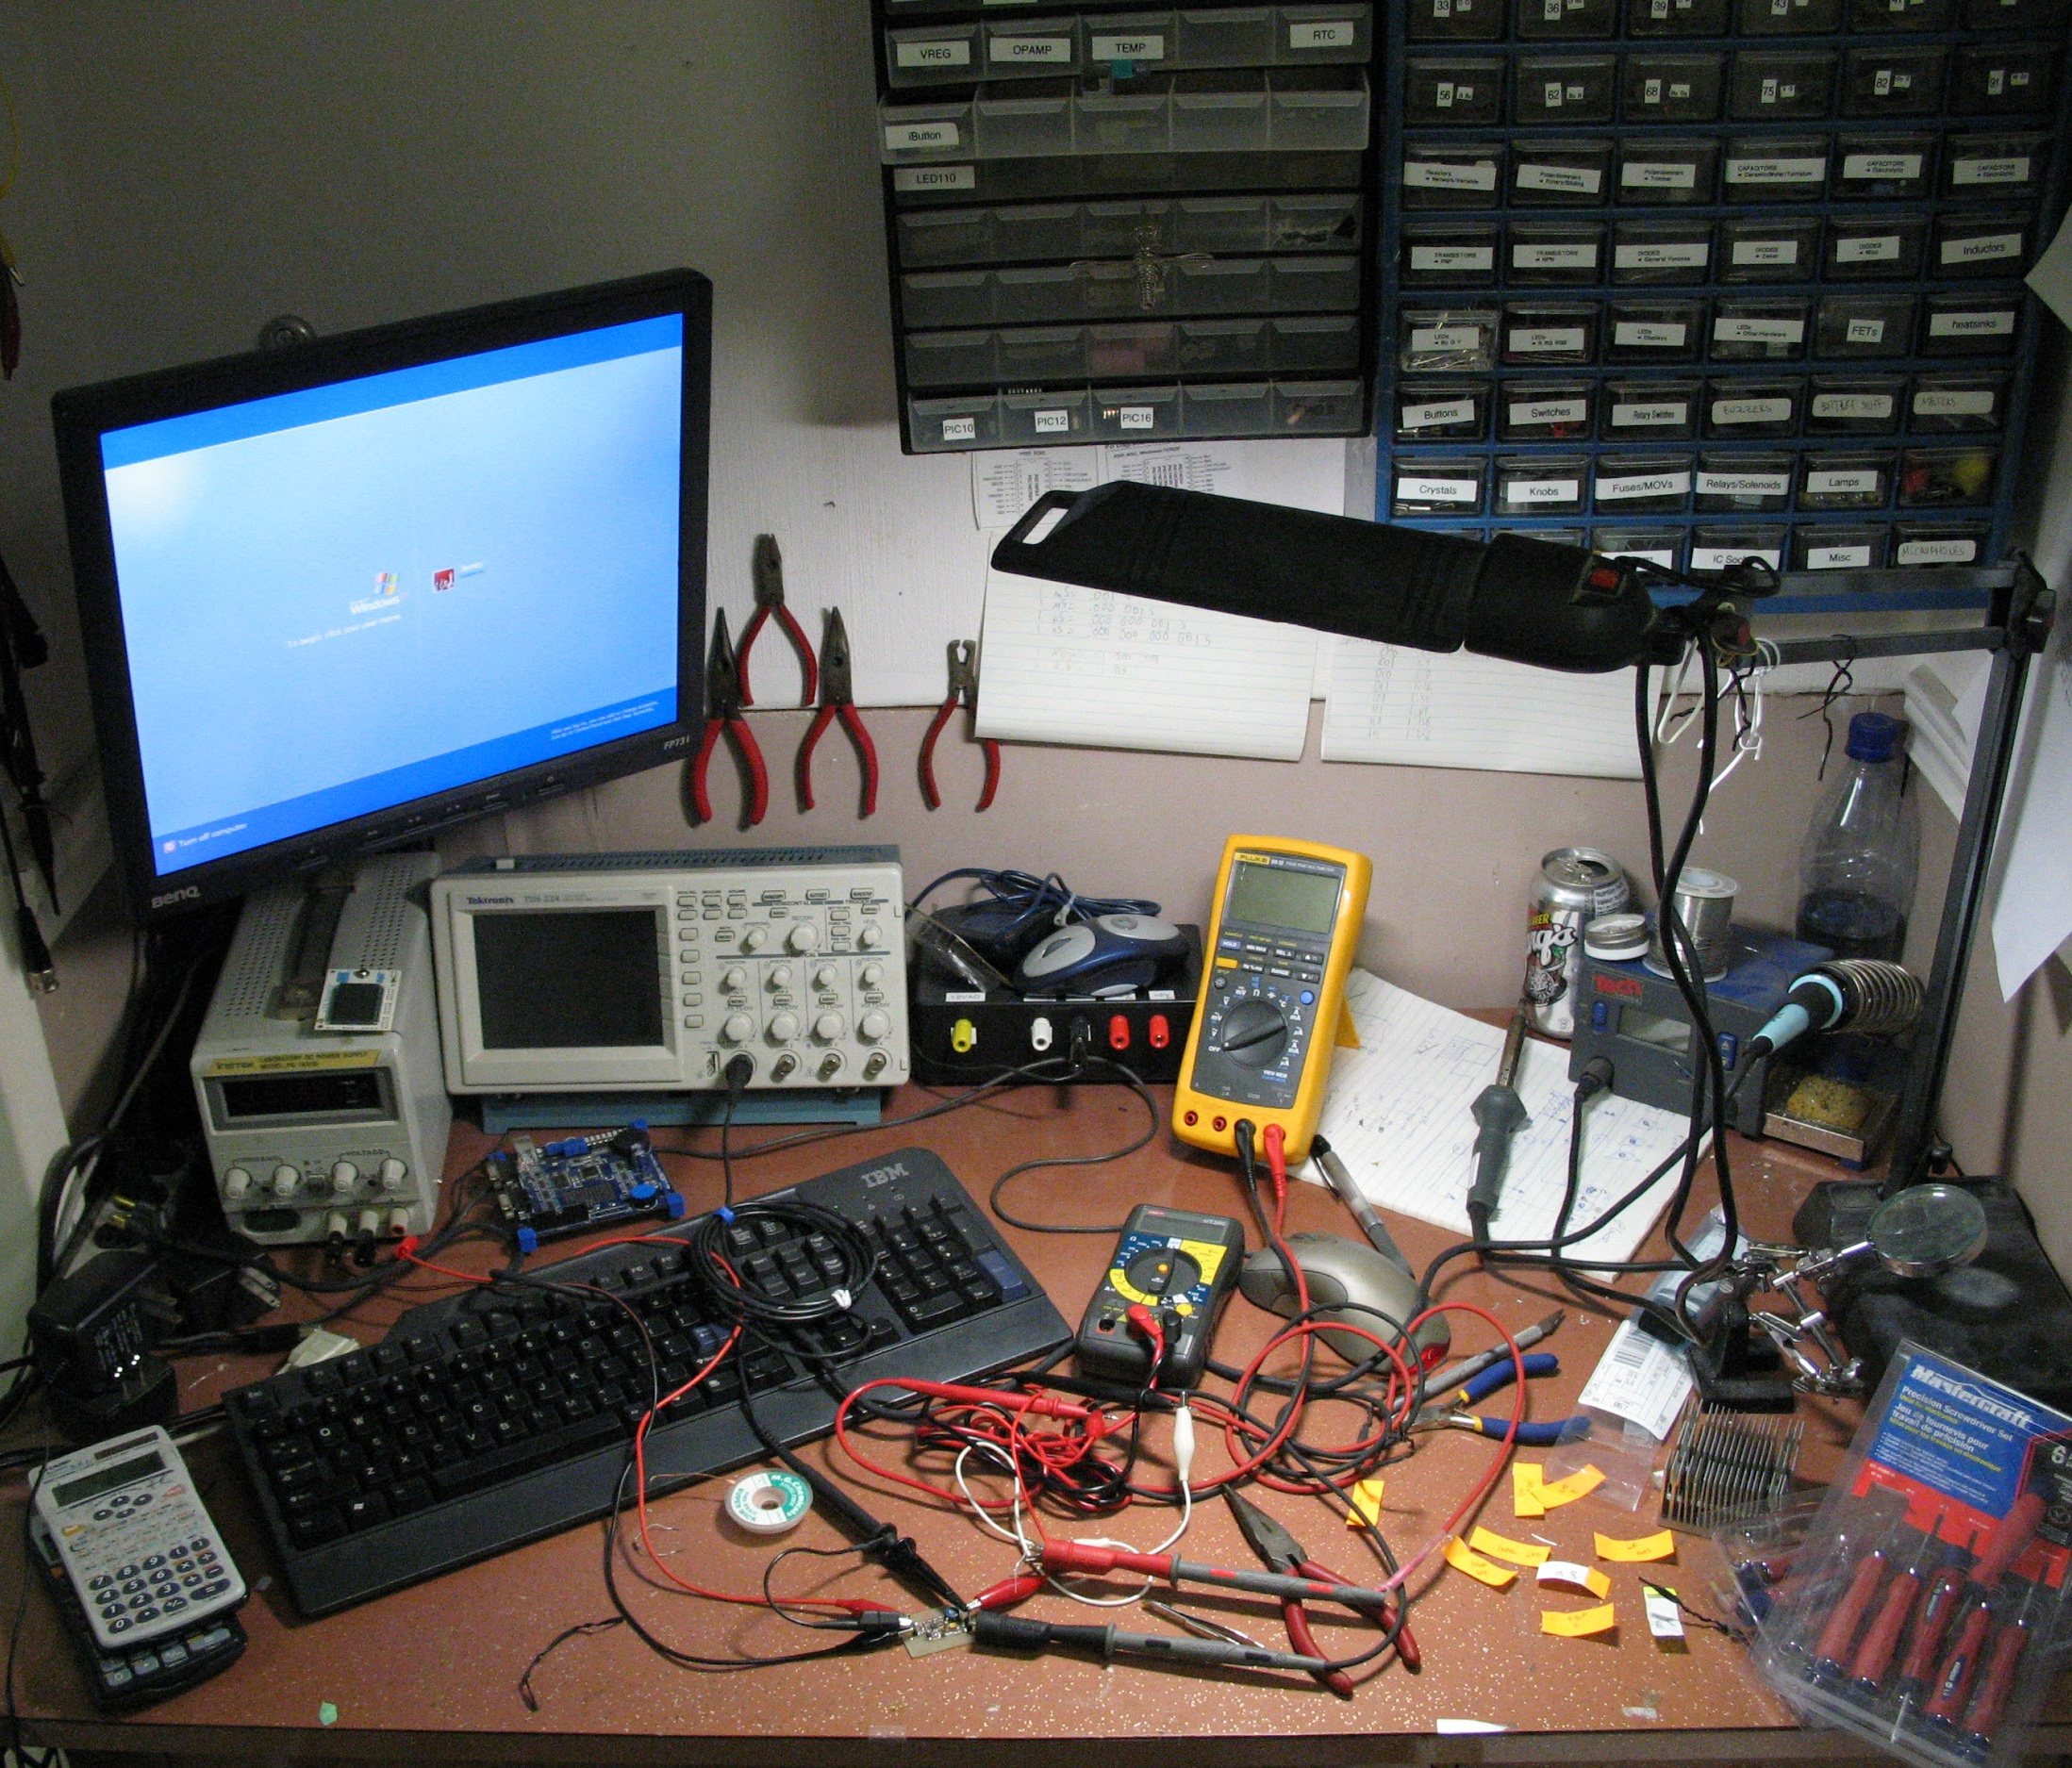
Create Your Mad-Scientist Lab

Slide 5
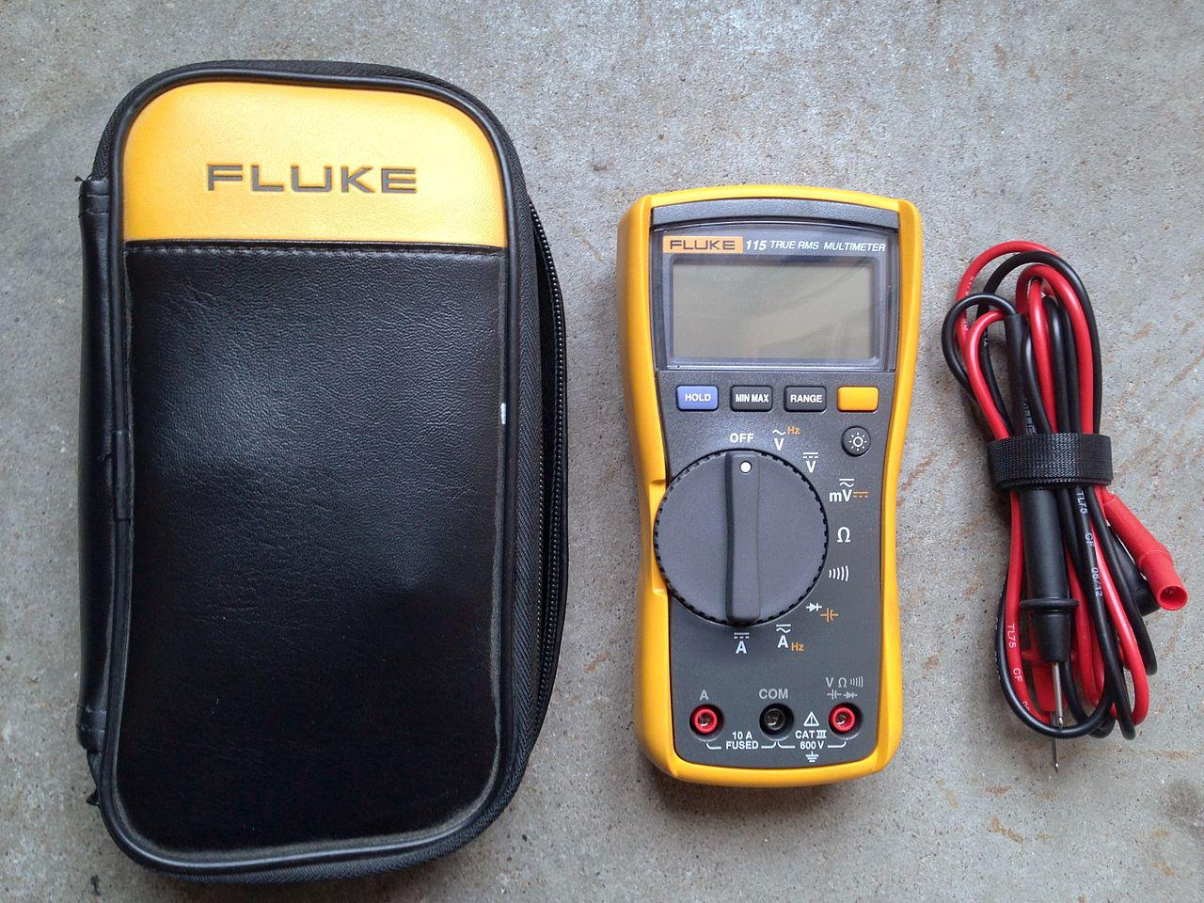
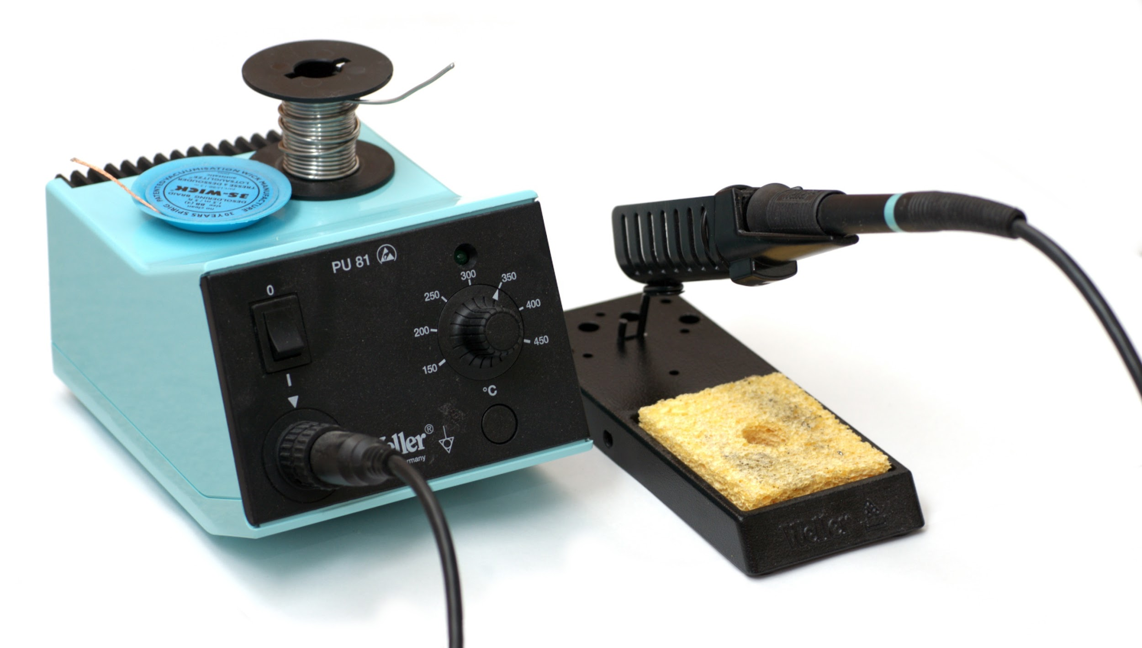
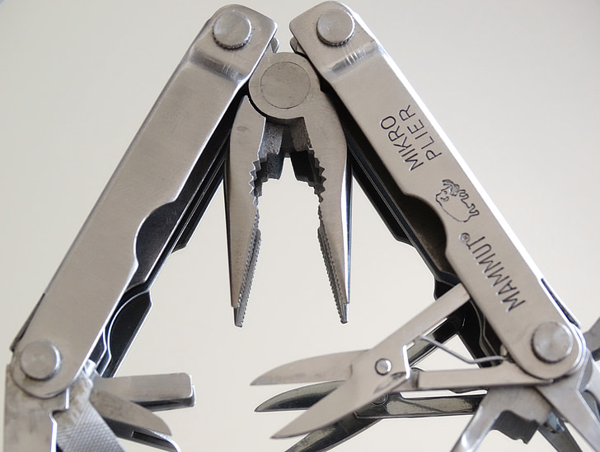
Must Have Tools
Multimeter Digital
Solder Station
Tang, obeng, dll

Slide 6
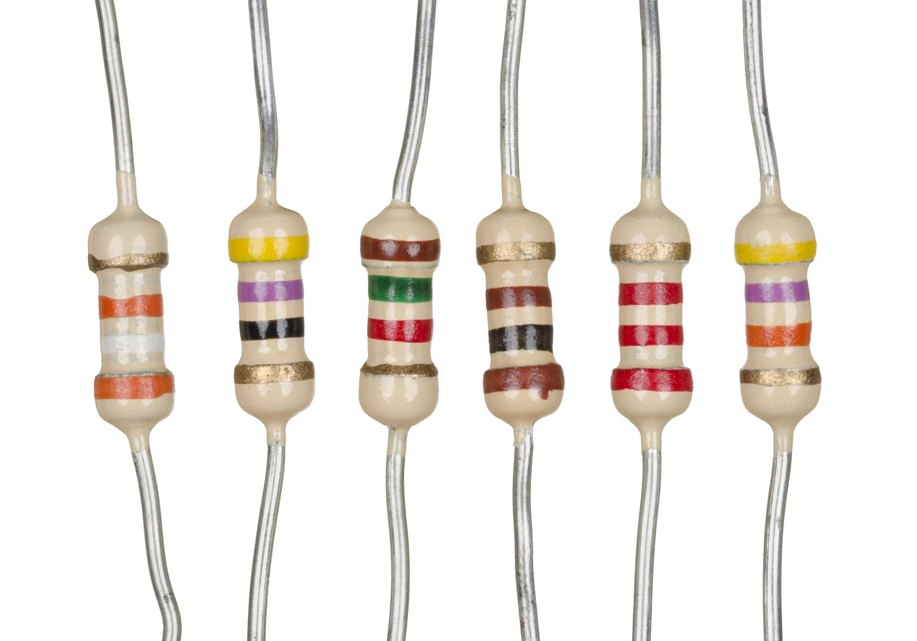
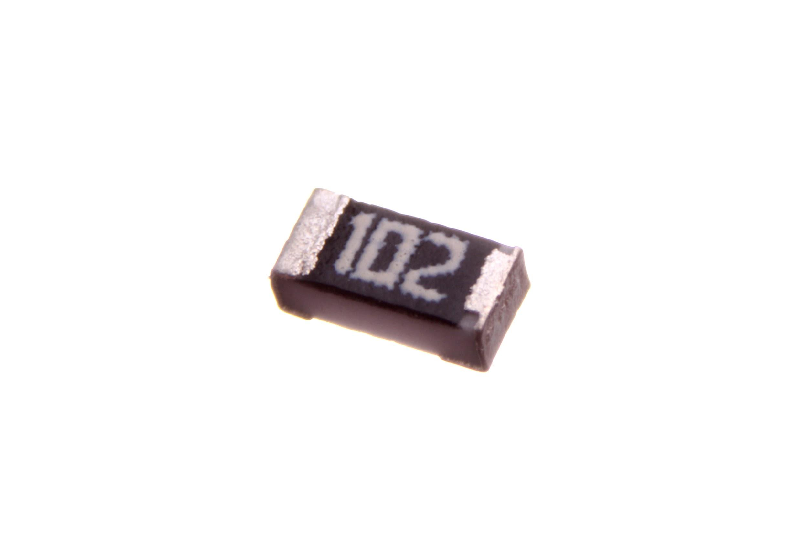

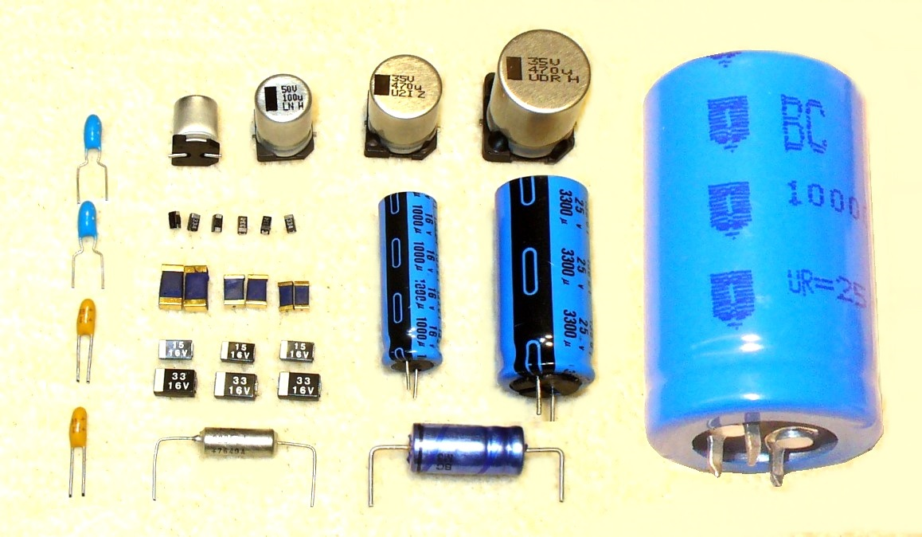
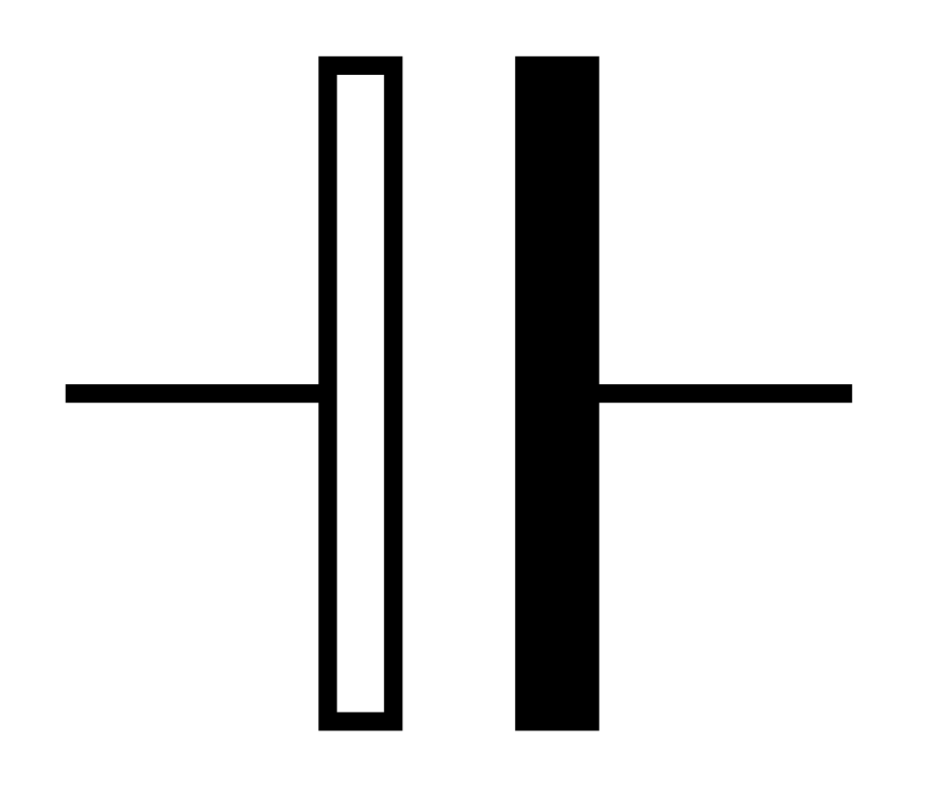
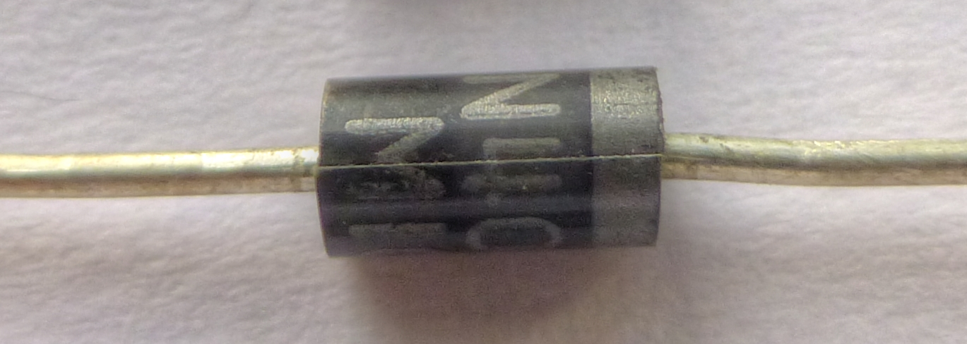
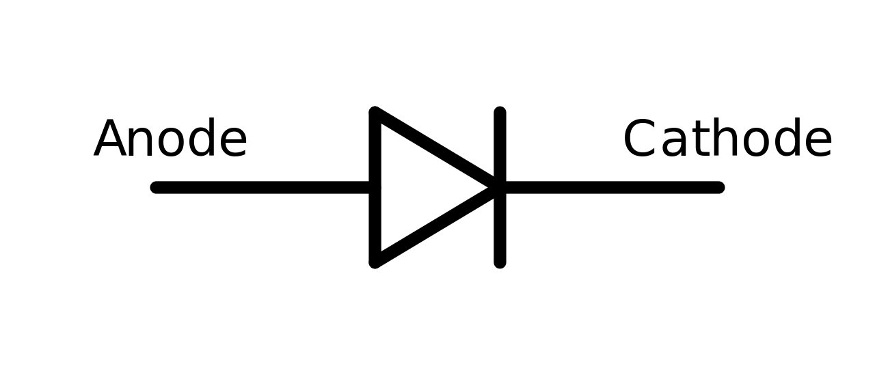
Stok Komponen
Resistor:
470Ω, 4.7㏀, 47㏀, 470㏀, 1㏀, 10㏀, 100㏀, 1㏁, 2.2㏀, 22㏀, 33㏀, 220㏀
Kapasitor:
0.01µF, 0.1µF, 10µF, 470µF
Diode: 1N4007

Slide 7
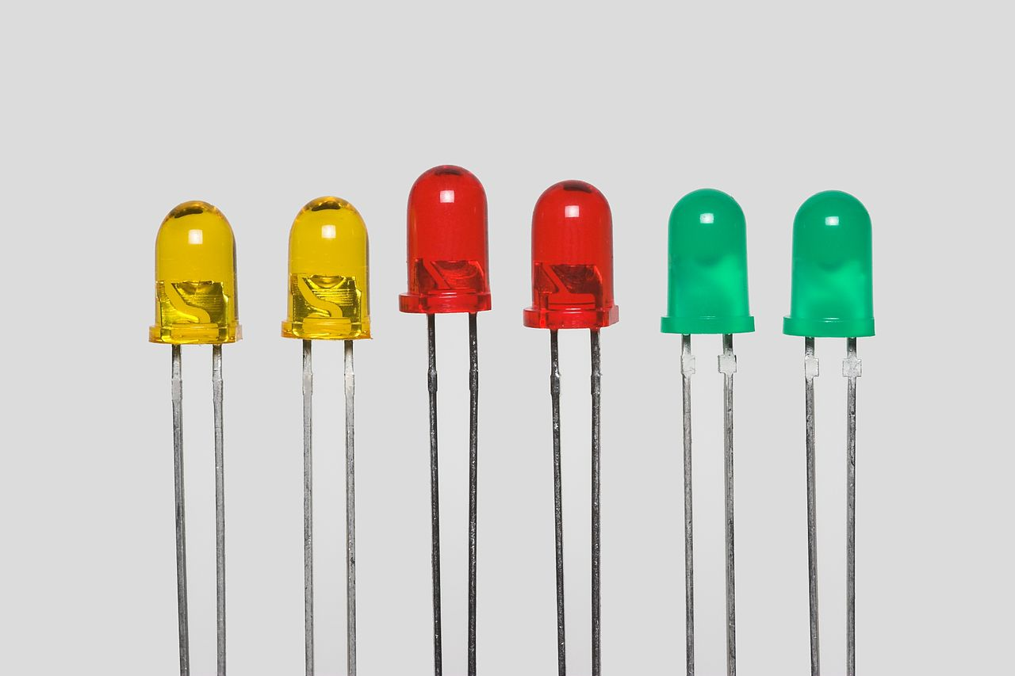
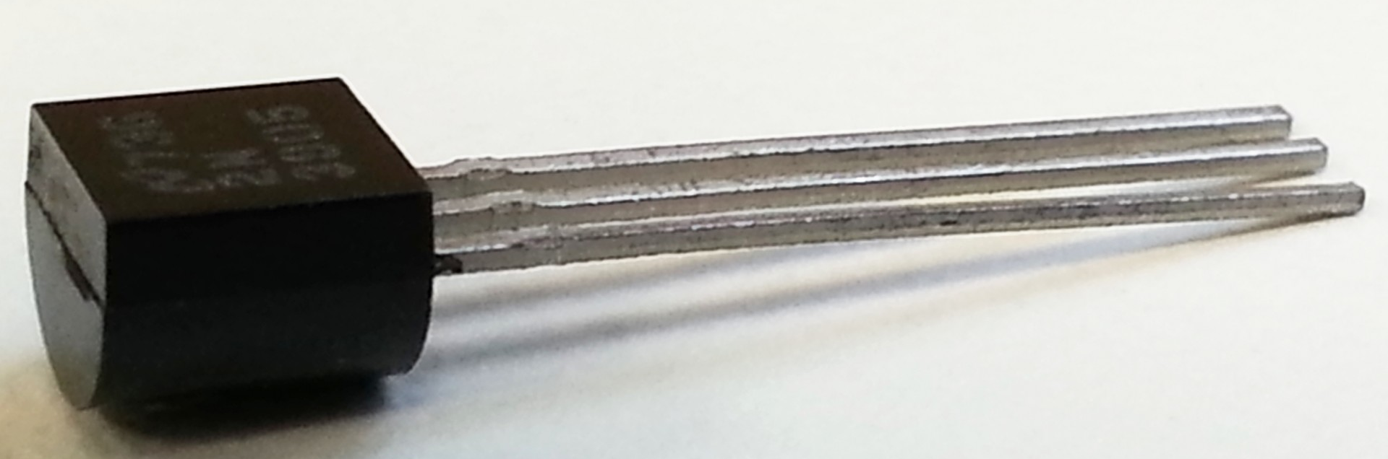
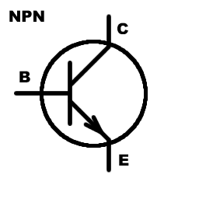
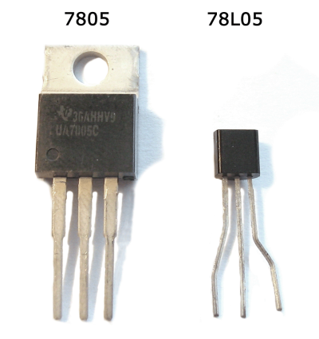
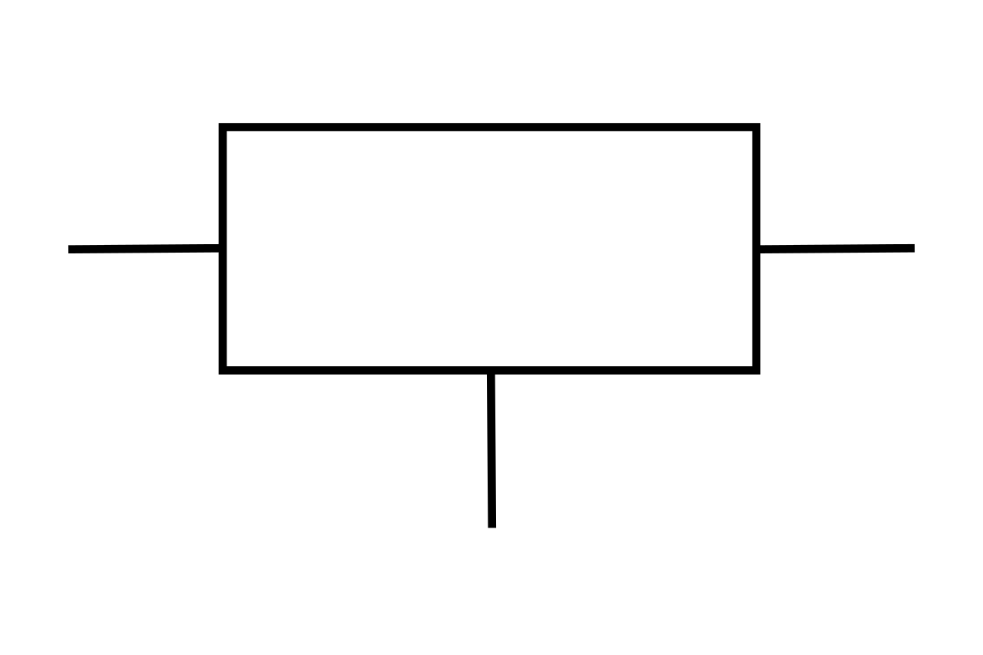
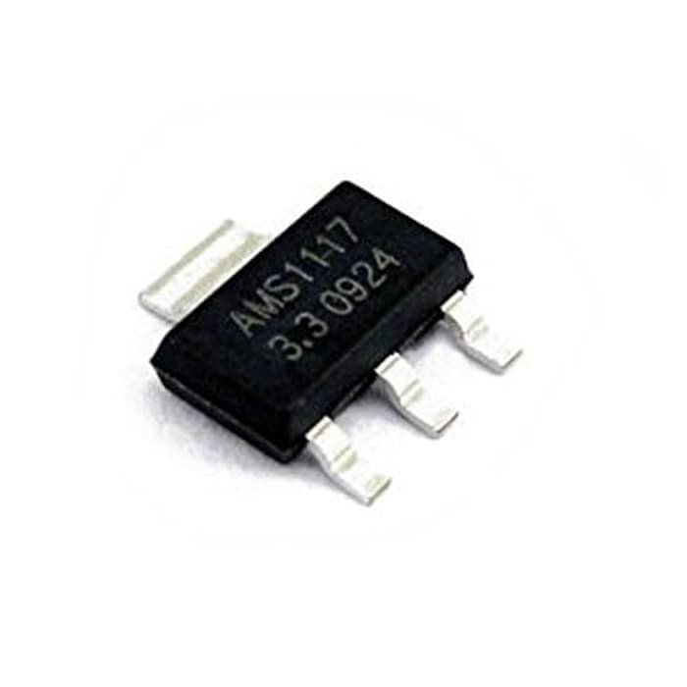
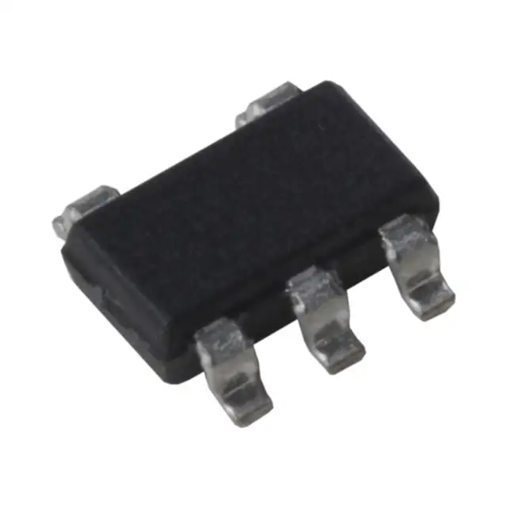
Stok Komponen
Led
Transistor NPN
BC547, BC338, S8050
Voltage Regulator
7805, AMS1117, AP2112

Slide 8
Build Process
Requirement
Environment?
Dimensions?
Power Source?
Lifetime?
Storage?
Connectivity?
Protocol?
Design Circuit
Read Datasheet
Choose Component
Draw Schematics
Do simulation
Build Prototype circuit
Build permanent circuit
Finishing

Slide 9
Tools
Circuit Design
KiCAD (Desktop, GNU GPL v3+)
EasyEDA (cloud)
DipTrace (Desktop, freeware)
3D Design
Autodesk 360 Fusion (Desktop app, cloud storage)
Onshape (cloud)
Manufacture / Prototyping PCB
FlatCAM
JLCPCB (online service)
Simulator (Spice)
Proteus
Ardusim
LTSpice

Slide 10
